Slide 1
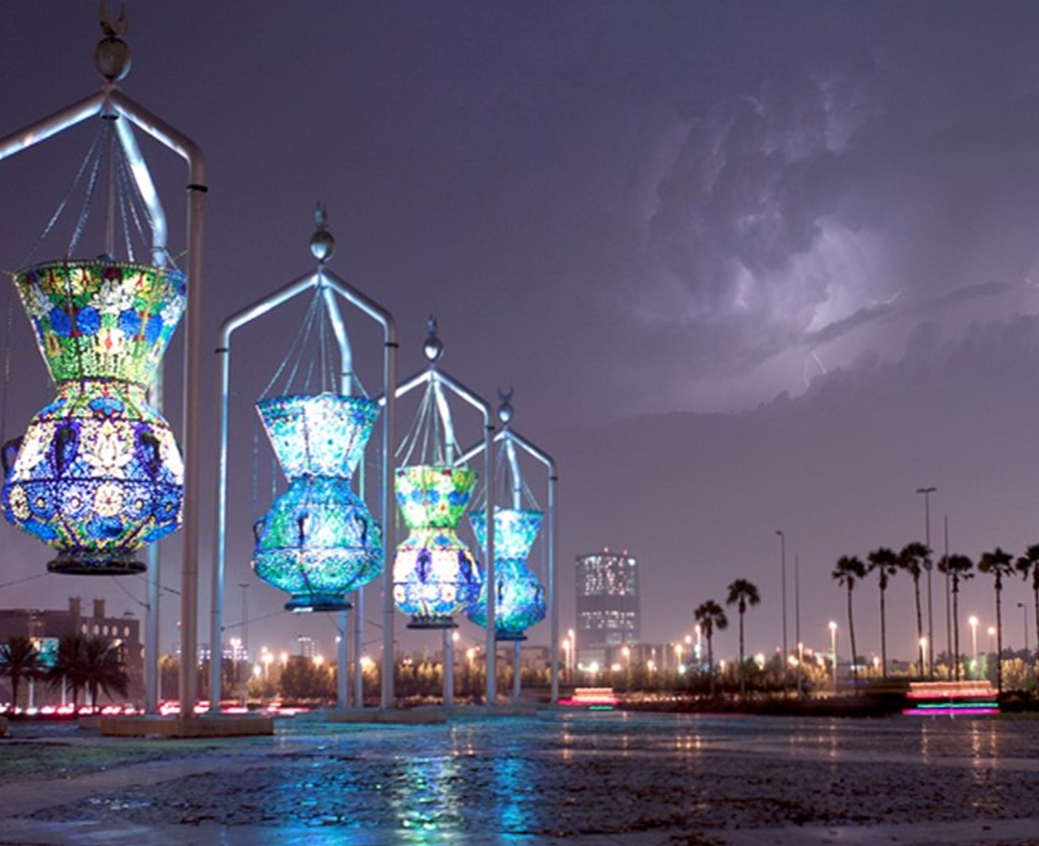

Kaffa Guideline
2023

Slide 2
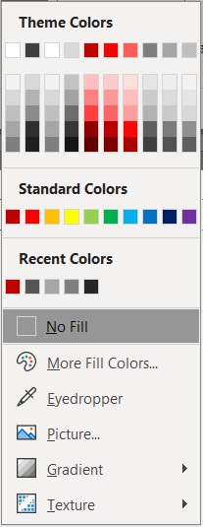
Colors
#C00000
Main Color
#FA0000
#FF5B5B
Secondary Color
#3F3F3F
#7F7F7F
#F2F2F2
Neutral Color
Notes:
Enhance the look and feel

Slide 3
Typography
Alphabet Format
Arabic Format
Slide Title using Nexa Bold 20pts
عناصر مكاتب
HelveticaNeueLT Arabic 75 Bold, 20pts
Subtitle using Nexa Light 14pts
عناصر مكاتب تحقيق الرؤية
HelveticaNeueLT Arabic 45 Light, 14pts
Heading using Nexa Bold 16pts
عناصر مكاتب
HelveticaNeueLT Arabic 75 Bold, 16pts
All content using Nexa Light 14pts
عناصر مكاتب تحقيق الرؤية
HelveticaNeueLT Arabic 45 Light, 12pts
Bullet point format using this setting. Just simply use format painter from this text box.
…
…
…
عناصر مكاتب تحقيق الرؤية
...
...
...

Slide 4
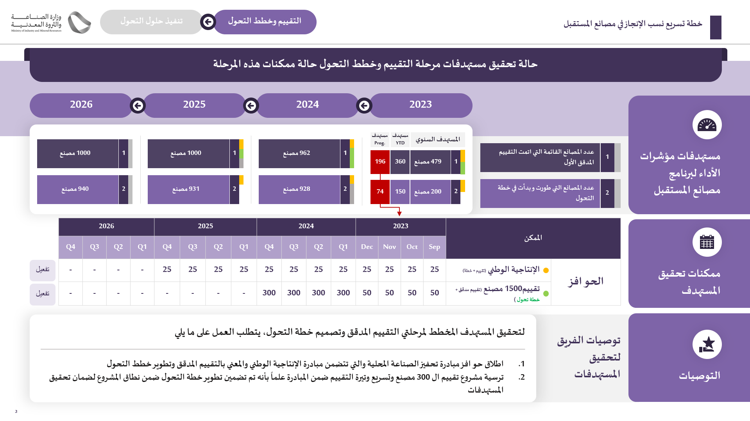
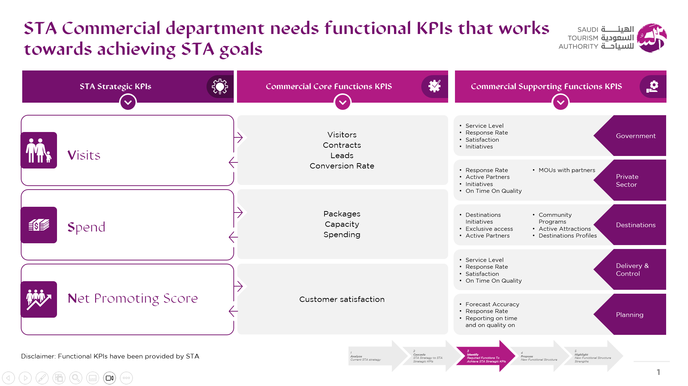
Additional Typography
Sakkal Majjala
Displace 2.0
Gotham
Use Sakkal Majjala when you working on non-Kafaa Template (red template).
This purple template (Saudi Tourism Authority) specifically using this font.
**Don’t worry, PM always provided prev order that include the font. So, just follow that choice.

Slide 5
Shape and icon
You can use those basic shape and combination, Kafaa is very open about this creativity. Also, they use filled icon.

Slide 6
Layout treatment development
Original layout
Adjusted layout
Kafaa’s layout treatment are vary and dynamic. They usually use breakdown layout that has very different perspective from the original but still maintain its hierarchy.
AND IT IS A MUST.
1
2
1
2
A
A
B
C
D
E
A
B
C
D
E
A
B
B
C
C
D
D
E
E
3
4
3
4
A
A
B
C
D
E
A
B
C
D
E
E
B
A
B
C
D
E
D
C
5
6
5
6
A
A1
A
A
A
B
A2
A1
A1
A2
A3
A1
B1
Here’s some trick
A3
B
B1

Slide 7
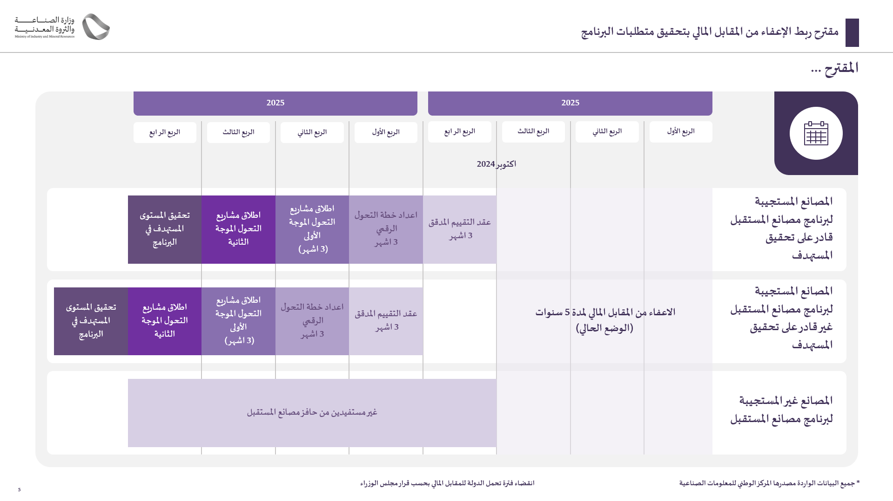
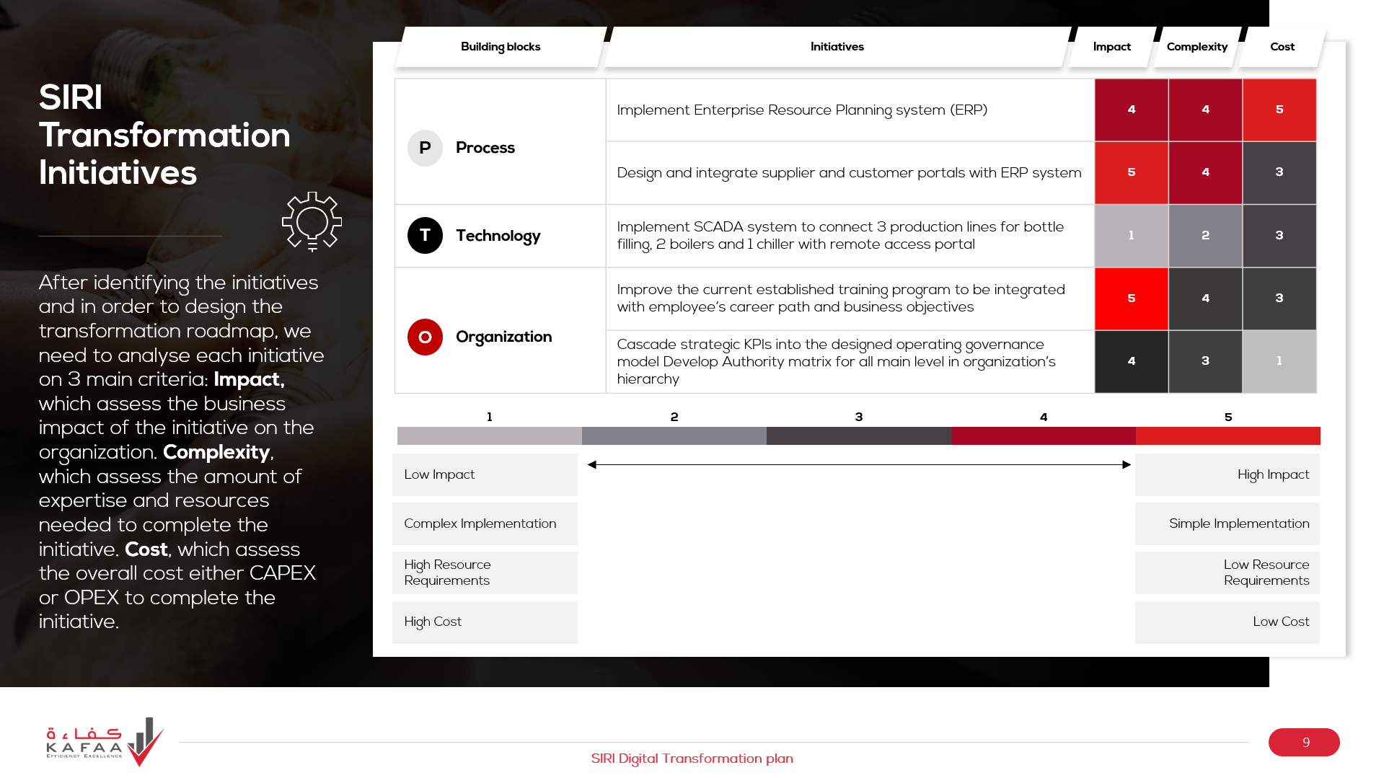
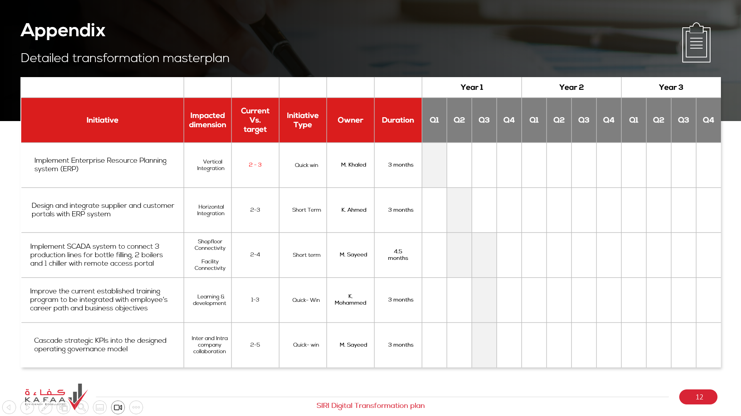
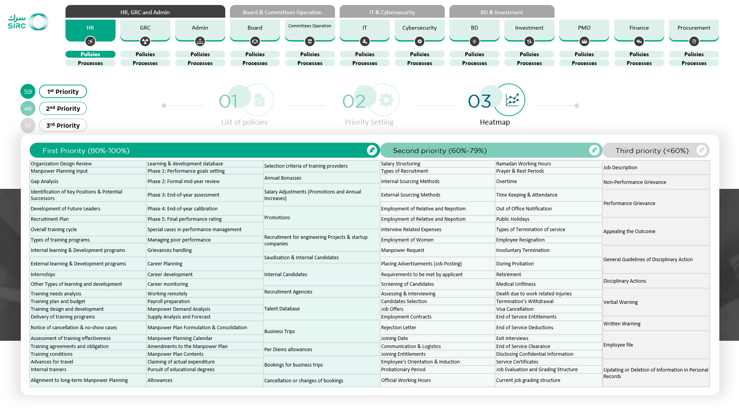
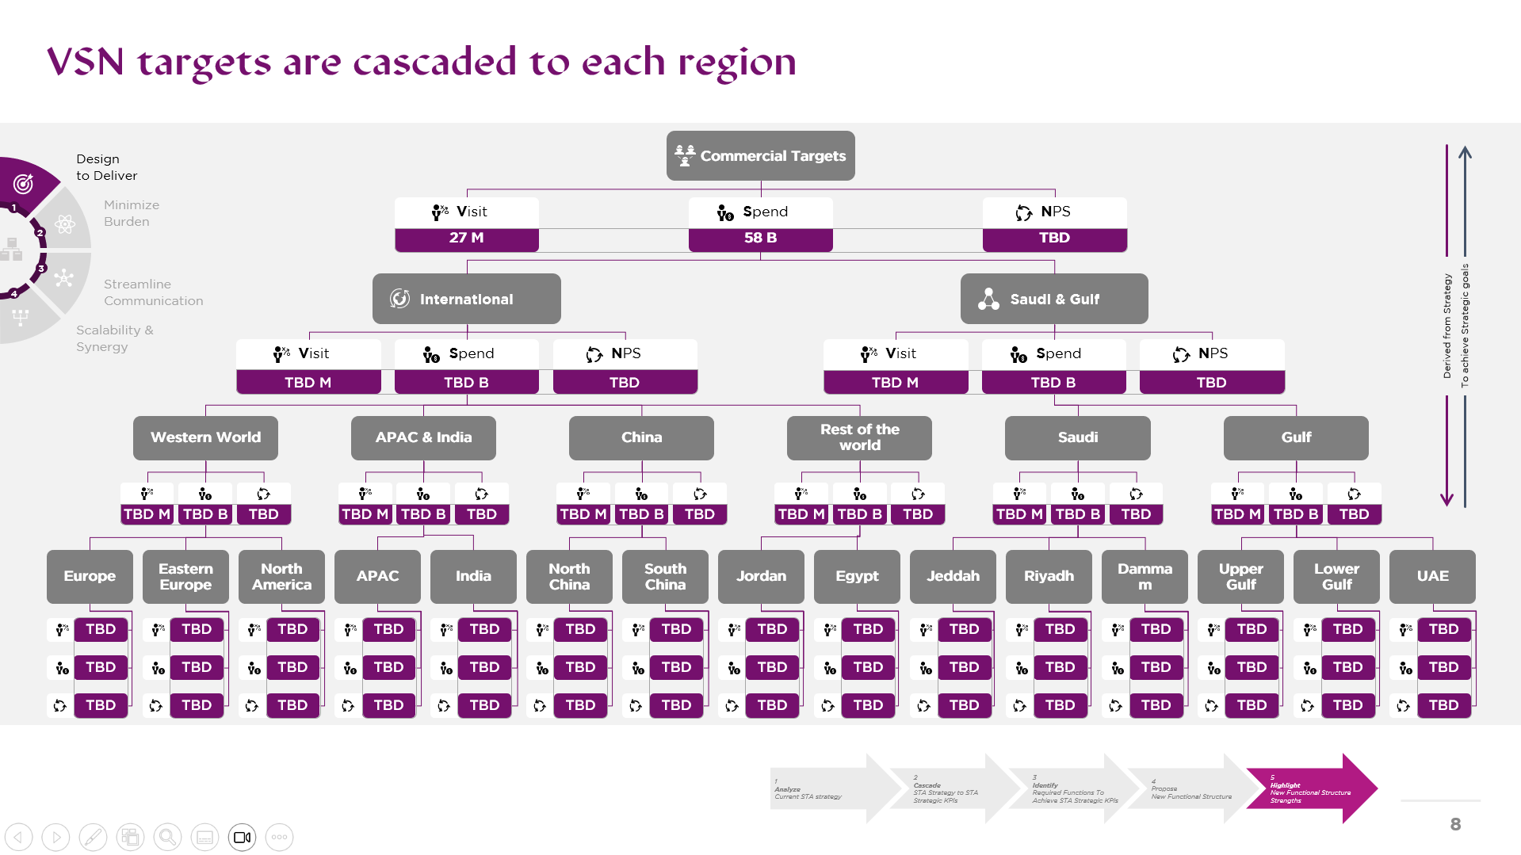
Layout treatment development
Eventhough, There are still a condition where you can’t break the layout. Better keep your layout when you facing heavy contents tables, dashboard, or complex timeline.
Here’s some example

Slide 8
Customer Documentation
You can visit here to get all the materials, including template variations, fonts, and previous order.
https://cloud.24slides.dev/s/CjCdfoAADZC8BK9

